Slide 1
Level 1 Chapter 5: Data Security and Compliance

Slide 2

What is data security?
Data security is a set of protective measures designed to safeguard corporate data from unauthorized access, theft, or misuse. As people continue their transition to flexible and remote work, increasing data security should be made a top priority.
Data security is essential to ensuring productivity—especially now that the corporate network often includes people’s personal devices. The following are some reasons to make data security a top priority.

Slide 3
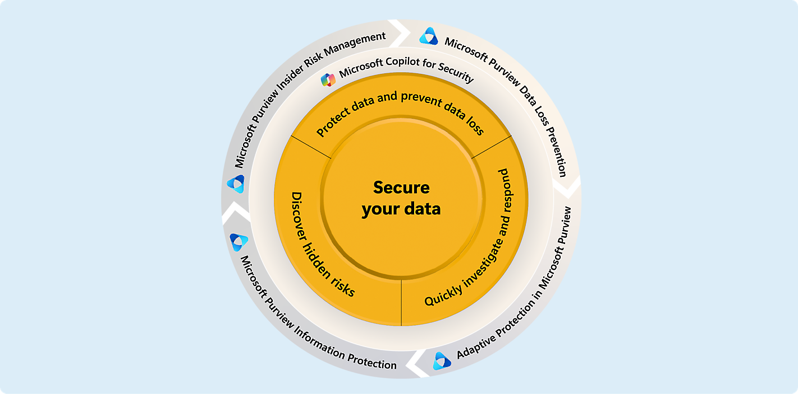
What is data security?

Slide 4
What is data security?
Data security involves knowing what data you have and where it’s located, and identifying risks around your data. Learn how to safeguard your data.
https://www.microsoft.com/en-in/security/business/security-101/what-is-data-security

Slide 5
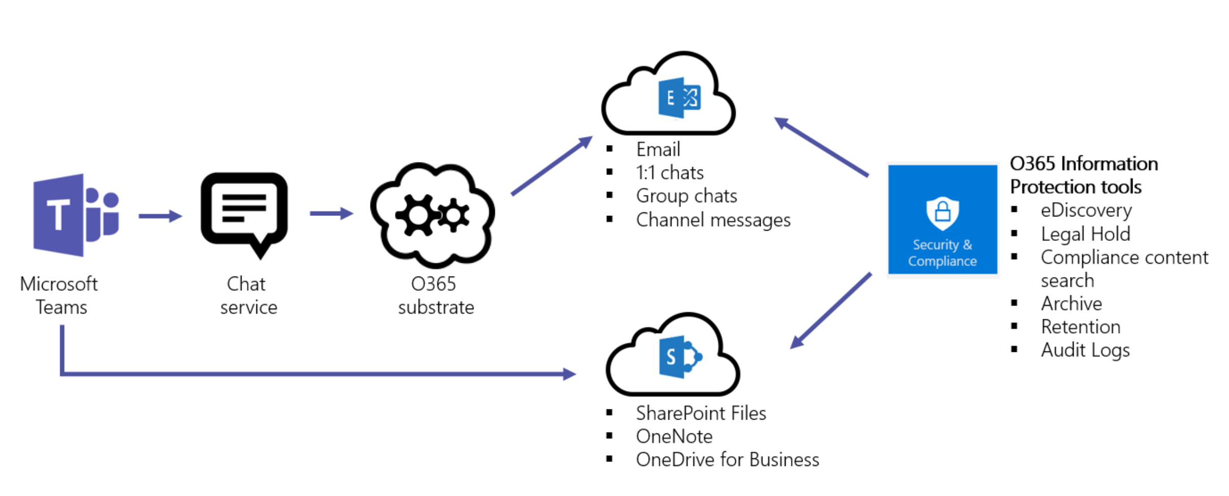
What is data security?

Slide 6
Data protection and privacy Data Protection with Microsoft Privacy Principles | Microsoft Trust Center https://www.microsoft.com/en-in/trust-center/privacy https://www.microsoft.com/en-in/security/business/security-101/what-is-data-protection

Slide 7
Thanking you !!!
Any Question !!!!

